Slide 1
Employed postgraduates: UCU is for you
www.ucu.org.uk

Slide 2
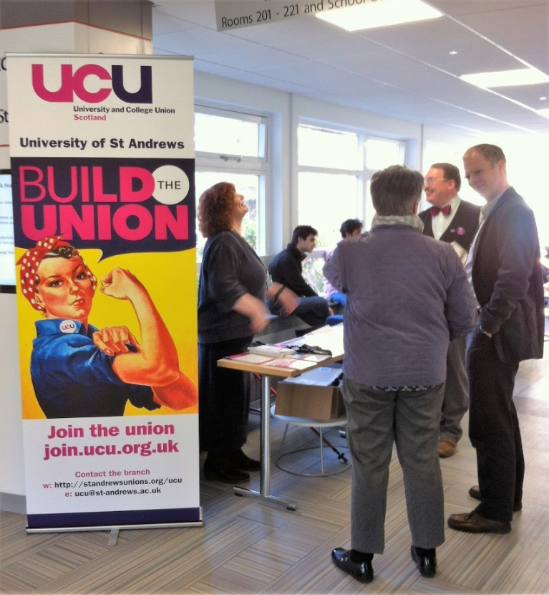
UCU: who we are
UCU is a trade union representing academic and academic-related staff, including PG tutors and demonstrators.
The St Andrews branch has an active focus on supporting early career academic staff and employed postgraduates.
The branch is currently negotiating improved contractual terms and conditions for PGs who teach.
UCU’s national pay campaign aims to close the gender pay gap and end casualisation.

Slide 3
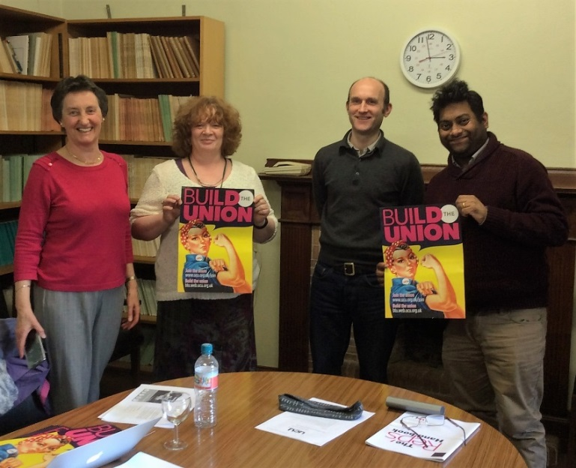
UCU: why join?
UCU helps build your career:
Free CPD training (e.g. voice care, writing research grant application)
Guidance materials (e.g. Early Careers Guide for New Staff, Know Your Rights)
Young members network/ one-stop-shop (career development resources)
UCU is your voice at work:
Defending your pay and conditions
Campaigning on your behalf (e.g. job security, casual contracts)
Providing peace of mind (e.g. support, confidential advice, representation)

Slide 4
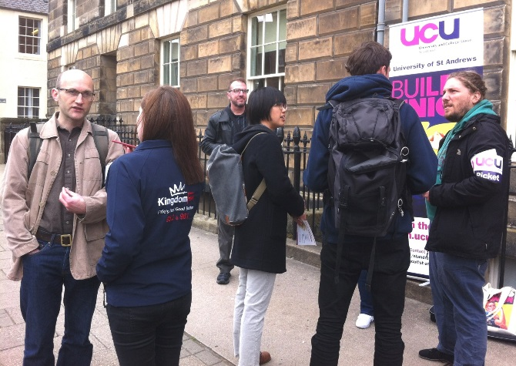
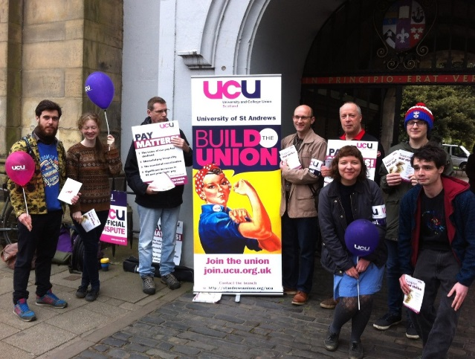
UCU: get involved
The more postgraduate members, the greater the voice for change.
Hourly-paid staff are OUR PRIORITY and we welcome YOUR input!
FREE, FULL, UCU MEMBERSHIP for research students who teach! www.ucu.org.uk/joinfree
@ucustandrews
http://standrewsunions.org/ucu Email: ucu@st-andrews.ac.uk

